Slide 1
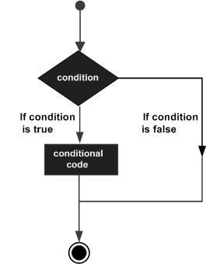
DECISION MAKING
Decision structures evaluate multiple expressions which produce TRUE or FALSE as outcome.
Python programming language assumes any non-zero and non-null values as TRUE, and if it is either zero or null, then it is assumed as FALSE value.

Slide 2
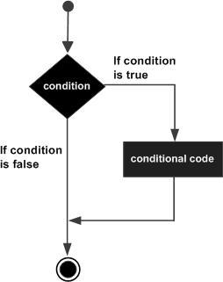
If Statement
The if statement contains a logical expression using which data is compared and a decision is made based on the result of the comparison.
Syntax
if expression:
statement(s)

Slide 3
Program
print( "Please enter a negative number" )
number = int( input( "> " ) )
if number >= 0:
print( "That wasn't negative!" )
else:
print( "Thank you!" )

Slide 4
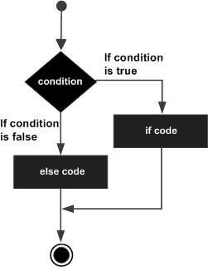
If…else Statement
An else statement contains the block of code that executes if the conditional expression in the if statement resolves to 0 or a FALSE value.
Syntax
The syntax of the if...else statement is:
if expression:
statement(s)
else:
statement(s)

Slide 5
Program
print( "Please enter a negative number" )
number = int( input( "> " ) )
if number >= 0:
print( "That wasn't negative!" )
else:
print( "Thank you!" )
# Our next example is a simple if/else if/else statement
print( "Which type of pet do you prefer?" )
print( " cats" )
print( " dogs" )
# Note how we use raw_input to get the input as a string
pet = input( "> " )
if pet == "cats":
print( "You chose cats." )
elif pet == "dogs":
print( "You chose dogs." )
else:
print( "That's not one of the choices." )
input( '\n\nPress Enter to exit...' )

